Slide 1
Presentation on Cyber Security of SCADA Systems
Prepared Under the Guidance of
Dr. Rajender Nath Sir
Submitted To: Submitted By: Mrs. Poonam Bhatia Mam Hitesh
Roll No 10
MCA 2nd Sem
Section B
Department of Computer Science and Applications
Kurukshetra University, Kurukshetra

Slide 2
Cyber Security of SCADA Systems
Introduction
SCADA- Supervisory Control And Data Acquisition
A SCADA system is a collection of both hardware and software components that allow supervision and control of systems, both locally and remotely. The SCADA also examines, collects and processes data in real time.
The systems I mention here are digital systems that make an advanced economy work and like all digital systems they are susceptible to Hacking.
These systems include –
1. Nuclear Power Plant Systems
2. Electrical Grid Systems
3. Air Traffic Control Systems
4. Railways Control Systems
5. Sewage and Water Systems
6. Financial Systems and ATMs
7. Oil and Gas Systems
8. Automatic Control Systems etc.

Slide 3
SCADA Application Areas

Slide 4
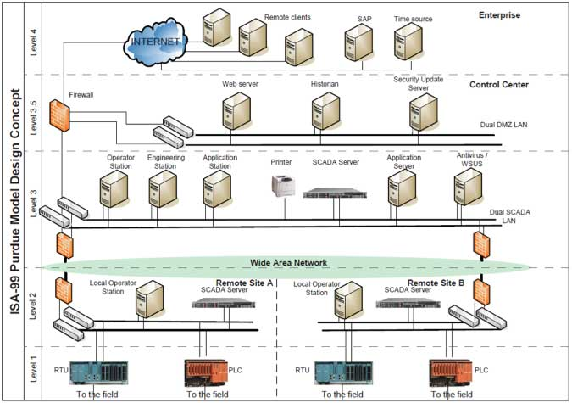
Architecture of a SCADA System

Slide 5
How SCADA systems work ?
The structural design of a standard SCADA system starts with Remote Terminal Units (RTUs) and Programmable Logic Controllers (PLCs).
RTUs and PLCs are microprocessors that communicate with field devices such as valves, pumps, motors, sensors etc. with the help of Human Machine Interface(HMI) software.
This communication is routed from the processors to the SCADA computers where the software interprets and displays the data allowing for operators to analyze and react to system events.

Slide 6
Technical Aspects of SCADA Systems
RTUs convert electronic signals received from field sensors into machine language, known as protocol, and transmit data over the communications network to the SCADA Master, where a human will use and manage that information.
A programmable logic controller is actually a control computer. The typical components include: 1) a CPU, 2) memory, 3) control software, 4) power supply, 5) input modules, and 6) output modules.
A key difference between the remote terminal unit (RTU) and the PLCs is PLCs are intended to control equipment because data moves in both directions.

Slide 7
Protocols used in SCADA communication
In order for SCADA systems to obtain its functionality, it needs a protocol for transmitting data. Some of the SCADA protocols include Modbus RTU, RP-570, Profibus and Conitel. These communication protocols are all SCADA-vendor specific but are widely adopted and used. Standard protocols are IEC(International Electrotechnical Commission) 60870-5 and DNP3.
IEC 60870-5 provides a detailed functional description for telecontrol equipment and systems for application in the electrical industries.
The DNP3 protocol is utilized in communication between HMI, the RTUs, and Intelligent Electronic Devices.
IEDs are the equipment of future power system automation, monitoring and control. IEDs include protective relaying devices, circuit breaker controllers, voltage regulators etc.

Slide 8
Taxonomy of Attacks
Threats | Description
Physical security | Bribe, employees working in past, threat calls etc.
Operating System Vulnerabilities | Patches to the SCADA system cannot be applied.
Improper authentication i.e. Unauthorized remote access | Remote access is more vulnerable to unauthorized access.
Audit and Accountability i.e. Monitoring and Defenses | Crypto. comm., IDS, firewall are not used. It is challenging to implement these crypto. approaches on sensors considering the resource capability and scale.
Wireless communication network | Depending on the implementation these links are vulnerable to the security attacks.
Upgrade restriction(Legacy Software) | Security of the system was not a consideration at that time.
Public Information | Sec. published design & arch. of SCADA system, making it available to attackers.

Slide 9
Important Attacks during 1982-2020
Attack title (Year) | Country (Industry) | Target | Impact | Type
Siberian Gas Pipeline Explo.(1982) | Russia (Petroleum) | Pipeline | Fin. Loss, System Damage | Malware
Nuclear Power Plant(1992) | Lithuania (Power and Utilities) | Reactor | System Damage | Malware (virus)
CSX train signaling system 2003 | United State (Transportation) | Signal dispatching system | Latency | Malware (virus)
Nachi worm on control servers(2003) | France (Chemical) | Advanced process controller | Latency | Malware (worm)
Stuxnet (2010) | Iran (Power/ Utilitis) | Centrifuges PLCs | Sys. Damage, Fin. Loss | Unauthorized Remote Access

Slide 10
Important Attacks during 1982-2020 Contd.
Attack title (Year) | Country (Industry) | Target | Impact | Type
North – Eastern India (2012) | Regional Electric Grids | NA | 70 million people , $100 million | Malware
Tehri Dam (Nov 2017) | Dehradun India | NA | Intellectual Loss | Malware
Haryana Discoms (March 2018) | India | NA | Intellectual Loss | Ransomware
Kudankulam Nuclear P.P. (Sep. 2019) | Tamil Nadu | Lack of antivirus, firewalls | Intellectual Loss | Trojan(Dtrack)
Elexon payment com. (15 May 2020) | Electric Grid UK | unpatched VPN server | Not Identified | Not Identified

Slide 11
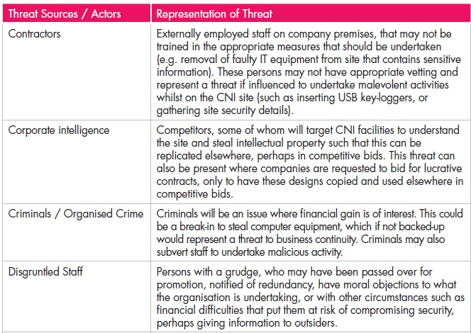
Typical Threat sources listed by CPNI (Centre for Protection of National Infrastructure)

Slide 12
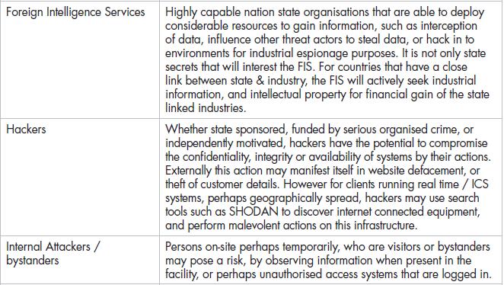
Threat Sources / Actors | Representation of Threat

Slide 13
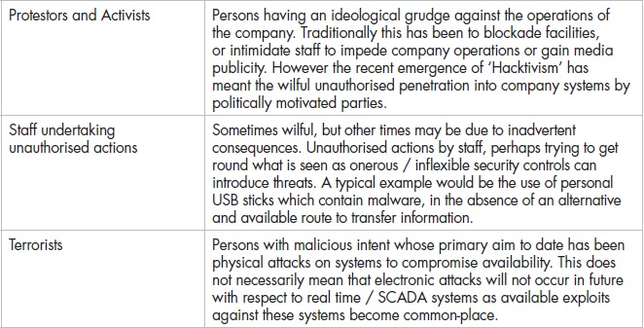
Threat Sources / Actors | Representation of Threat

Slide 14
Steps to increase security of SCADA systems
Identify all connections to SCADA networks.
Disconnect unnecessary connections & evaluate and strengthen the security of any remaining connections to the SCADA network.
Harden SCADA networks by removing or disabling unnecessary services.
Do not rely on proprietary protocols to protect system.
Implement the security features provided by device and system vendors.
Implement internal and external intrusion detection systems and establish 24-hour-a-day incident monitoring.
Perform technical audits of SCADA devices and networks, and any other connected networks, to identify security concerns.
Conduct physical security surveys and assess all remote sites connected to the SCADA network to evaluate their security.
Establish SCADA “Red Teams” to identify and evaluate possible attack scenarios.

Slide 15
Steps to increase security of SCADA systems Contd.
Clearly define cyber security roles, responsibilities, and authorities for managers, system administrators, and users.
Document network architecture and identify systems that serve critical functions or contain sensitive information that require additional levels of protection.
Establish system backups and disaster recovery plans.
Senior organizational leadership should establish expectations for cyber security performance and hold individuals accountable for their performance.
Establish policies and conduct training to minimize the likelihood that organizational personnel will inadvertently disclose sensitive information regarding SCADA system design, operations, or security controls.

Slide 16
Career Options for Students/ Professionals
Various Certification Courses Specially for Professionals who wish to choose ICS Security as advancement for their career
ISA99 Cyber Security Certification Program
Certified ICS/SCADA Security Architect(CSSA)
Global Industrial Cyber Security Professional (GICSP)
Certified Automation Professional (CAP)
Industrial Security Professional (ISP)
Other Certifications for both CISSP, CISM, CEH, COMPTIA Security+, OSCP, CCSP, APT, GIAC, CHFI, CES, CND, PLC programming etc.
Recruitment Under Ministry MEIT, DoT, NTRO, DRDO

Slide 17
THANK YOU

